Slide 1


BOSH Fundamentals
Vivian Fialho – Platform Architect
vfialho@pivotal.io

Slide 2
Agenda
BOSH Overview
BOSH Architecture
BOSH Deployments and Releases
BOSH HA and Platform Updates

Slide 3
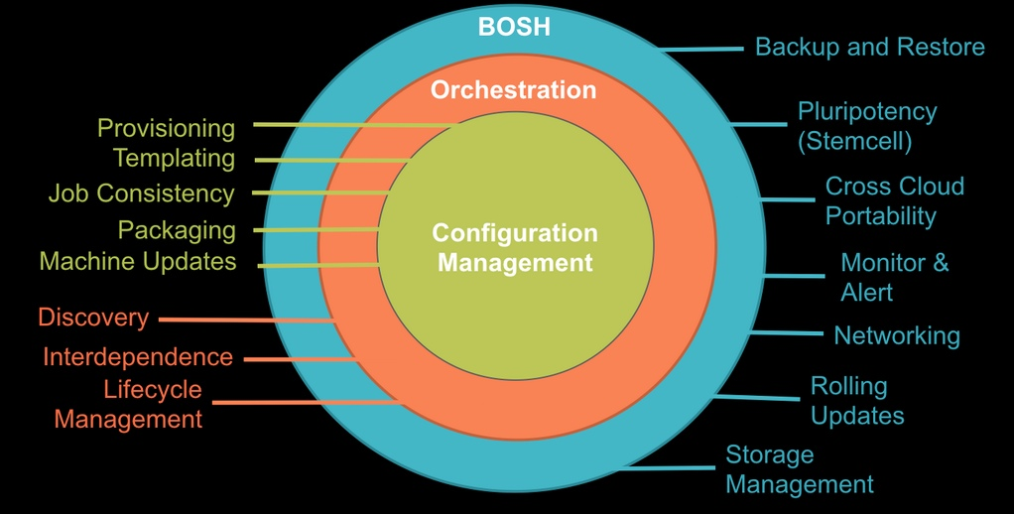
“ BOSH is an open-source tool chain for release engineering, deployment and lifecycle management of large-scale distributed services ”

Slide 4
Why BOSH?
Provision services, not machines
Enables continuous delivery
Cloud-agnostic view of Platform Ops
Holistic Toolchain for “rule them all"
Eliminate bespoke automation on top of config management

Slide 5



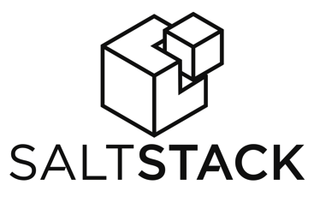
CM & Orchestration tools

Slide 6
What is missing?
These tools were designed to ensure servers are in a desired configuration, not to rapidly deploy software.
Coordinating actions across different systems is left up to the user, requiring scripts or other tools.
Manage services …not servers or VMs

Slide 7


BOSH (Outer Shell) Logical View
DB
Blob Store
Deploys and manages large scale distributed systems. BOSH provides the means to go from deployment (i.e., Chef/Puppet) to VM creation and management (i.e., cloud CPI). It includes interfaces for vSphere, vCloud, AWS and OpenStack. Additional CPI can be written for alternative IaaS providers.
Key Elements:
CLI
Director
Blobstore
Workers
CLI
Director
Worker
NATS
Health Monitor
CPI
Message Bus
Health Monitor
IaaS CPI
Agents
Inner shell
Agents
Outer shell

Slide 8
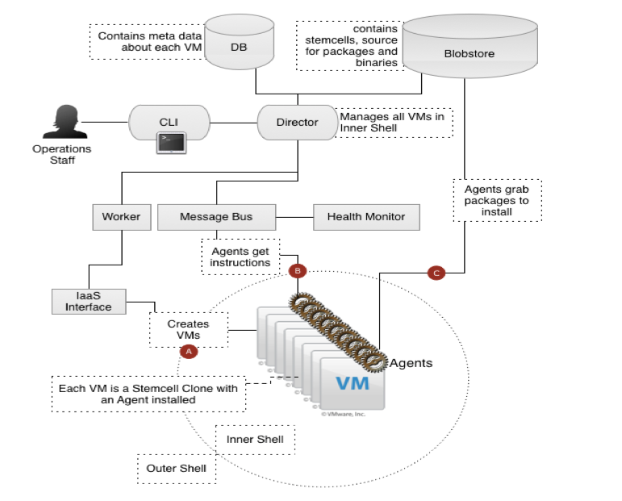
The BOSH Architecture
Very similar to CF architecture itself
Director as analogy to Cloud Controller
Different CPIs exist per IaaS implementation
Workers responsible for executing tasks as dictated by Director

Slide 9






BOSH: Cloud Provider Interface
Stemcell
create_stemcell(image, cloud_properties)
delete_stemcell(stemcell_id)
VM
create_vm(agent_id, stemcell_id, resource_pool,
networks, disk_locality, env)
delete_vm(vm_id)
reboot_vm(vm_id)
configure_networks(vm_id, networks)
Disk
create_disk(size, vm_locality)
delete_disk(disk_id)
attach_disk(vm_id, disk_id)
detach_disk(vm_id, disk_id)
IaaS Neutral
...ETC

Slide 10

3 Components of a BOSH Deployment
Manifest
Stemcell
Release
Agent

Slide 11



BOSH deployment
DB
BOSH
Upload Stemcell
BOSH CLI
BOSH Director
Blobstore
NATS
Health
Monitor

Slide 12
BOSH deployment
DB
BOSH
Upload Release
BOSH CLI
BOSH Director
Blobstore
NATS
Health
Monitor

Slide 13
BOSH deployment
DB
BOSH
Set Manifest
BOSH CLI
BOSH Director
Blobstore
NATS
Health
Monitor

Slide 14

BOSH deployment
IaaS
DB
BOSH
Deploy
BOSH CLI
BOSH Director
Worker VMs
Blobstore
NATS
Target VM
Target VM
Health
Monitor
Target VM
BOSH agent

Slide 15
3 Components of a BOSH Deployment
Manifest
Deployment Descriptor
Stemcell
Release
Agent
VM / Container template + Agent

Slide 16

… so what exactly is a BOSH release?
Release

Slide 17

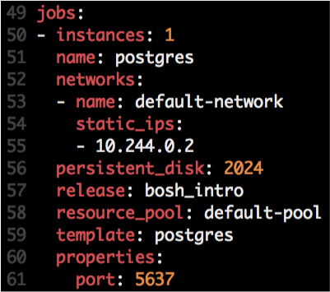



Anatomy of BOSH releases
Release
Job
Stemcell
Monit script
OS Process
OS Process
Instantiated in runtime based on
OS Process
Agent
Monit
Monit
Monit
Manifest
Depends
src
Scripts:
Example of Jobs:
DEA (CF)
CloudController (CF)
Service Broker (MySQL & Rabbit)
Locator (possible GemFire release)
Packaging
Depends
Packages
Pre-Packaging
Depends
Blobs
Depends
http://docs.cloudfoundry.org/bosh/create-release.html

Slide 18

Job Creation
Deployment
Stemcell
VM / Container
Job
VM / Container
BOSH Director
Ping
Agent
OS Process
Agent
Monit
NATS
Agent
Ping
Job
Health Monitor
OS Process
Compiled Packages
Monit

Slide 19

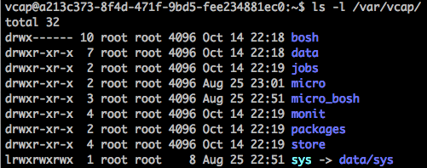
Logs
Deployment
Stemcell
Job
VM / Container
BOSH Director
Agent
Ping
OS Process
NATS
Monit
Agent
Log: /var/vcap/monit/monit.log
Health Monitor
Logs: /var/vcap/sys/logs/<job>
Logs: /var/vcap/sys/logs/hm9000*.log
Compiled Packages

Slide 20

BOSH and High Availability
Notes:
(bold moves)
2015 – This is..
The year where we see a level of adoption of our products and services that propels us to becoming an ipo-worthy company
This is..the year where our great vision becomes a reality in production environments at the most important companies and organizations in the world.
This is the year that we show and teach our customers and partners the power and opportunity that building great software brings.

Slide 21

4 Layers of Built-in High Availability
Application Instance
Platform Processes
Platform VMs
Availability Zones

Slide 22
4 Layers of Built-in High Availability
Application Instance
Platform Processes
Platform VMs
Availability Zones

Slide 23
Application Instance HA
Pivotal Cloud Foundry
Elastic Runtime
Desired State
Blobstore
Cloud Controller
Service
credentials
DB
creds
Cloud Controller Bridge
Router
Access App
BBS
Converger & Auctioneer
Cell
Cell
Cell
creds
creds
Actual State

Slide 24
4 Layers of Built-in High Availability
Application Instance
Platform Processes
Platform VMs
Availability Zones

Slide 25
Platform Process HA
BBS
AGENT
Health Monitor
Restart!
Responses:
CELL
pager
AGENT
Message Bus
email
monitoring
…
Cloud Controller
AGENT
BOSH
IaaS
Notes:
The processes running on the virtual machines (i.e. the health manager) are started with monit, a nice little utility that keeps an eye on processes and will respond when one dies. If a process dies then, monit will do two things: first, it will try to restart the process and second, whether the restart is successful or not, it will tell the BOSH agent about the failure. Recall that the Bosh agent is there to communicate with Operations Manager and in this case it will relay this failure information to the Operations Manager Health Monitor (not to be confused with the Health Manager of the elastic runtime that was discussed above) – we’ll abbreviate it OMHM. The OMHM will take this alert and pass it through a list of responders that can be configured to do things like send emails, page administrators and display alerts in operations dashboards. There’s a good chance that monit will already have recovered the process, but we also want there to be an opportunity for a human to respond.

Slide 26
4 Layers of Built-in High Availability
Application Instance
Platform Processes
Platform VMs
Availability Zones

Slide 27
Platform VM HA
BBS
Desired State
Actual State
AGENT
Health Monitor
BOSH Director
Responses:
CELL
pager
AGENT
Message Bus
email
monitoring
resurector
Cloud Controller
…
AGENT
BOSH
IaaS
Notes:
Of course, the BOSH agent on a VM can only communicate back to the Operations Manager if the VM is there, so let’s talk about what happens when a VM disappears. First thing to understand is that by “disappear” I mean that the BOSH agent is not functional; the VM could be there, but Ops Manager no longer knows what it is up to so for all intents and purposes it’s “gone”. How does Ops Manager know? One of the things that a BOSH agent is responsible for is sending out heartbeat messages and by default it does so every 60 seconds. The OMHM is constantly listening for those heartbeats and when it finds that one is missing it will itself produce and alert and pass that through the list of responders. Just as described above, this could result in emails, pages and operations dashboard alerts, but in this case there is one more responder that kicks in – the “resurector”. The resurector will communicate with the IaaS over which PCF is running and will ask that the failed VM be replaced. Of course it will be replaced with a VM running the appropriate part of the elastic runtime – i.e. a health manager or DEA, etc. That’s right, Operations Manager will restart failed cluster components.

Slide 28
Platform VM HA
BBS
Desired State
Actual State
AGENT
Health Monitor
BOSH Director
Responses:
CELL
pager
AGENT
Message Bus
email
monitoring
resurector
Cloud Controller
…
AGENT
BOSH
IaaS
Notes:
Of course, the BOSH agent on a VM can only communicate back to the Operations Manager if the VM is there, so let’s talk about what happens when a VM disappears. First thing to understand is that by “disappear” I mean that the BOSH agent is not functional; the VM could be there, but Ops Manager no longer knows what it is up to so for all intents and purposes it’s “gone”. How does Ops Manager know? One of the things that a BOSH agent is responsible for is sending out heartbeat messages and by default it does so every 60 seconds. The OMHM is constantly listening for those heartbeats and when it finds that one is missing it will itself produce and alert and pass that through the list of responders. Just as described above, this could result in emails, pages and operations dashboard alerts, but in this case there is one more responder that kicks in – the “resurector”. The resurector will communicate with the IaaS over which PCF is running and will ask that the failed VM be replaced. Of course it will be replaced with a VM running the appropriate part of the elastic runtime – i.e. a health manager or DEA, etc. That’s right, Operations Manager will restart failed cluster components.

Slide 29
Platform VM HA
CPI
BBS
Desired State
Actual State
AGENT
Health Monitor
BOSH Director
Responses:
CELL
pager
AGENT
Message Bus
email
monitoring
resurector
Cloud Controller
…
AGENT
BOSH
IaaS
Notes:
Of course, the BOSH agent on a VM can only communicate back to the Operations Manager if the VM is there, so let’s talk about what happens when a VM disappears. First thing to understand is that by “disappear” I mean that the BOSH agent is not functional; the VM could be there, but Ops Manager no longer knows what it is up to so for all intents and purposes it’s “gone”. How does Ops Manager know? One of the things that a BOSH agent is responsible for is sending out heartbeat messages and by default it does so every 60 seconds. The OMHM is constantly listening for those heartbeats and when it finds that one is missing it will itself produce and alert and pass that through the list of responders. Just as described above, this could result in emails, pages and operations dashboard alerts, but in this case there is one more responder that kicks in – the “resurector”. The resurector will communicate with the IaaS over which PCF is running and will ask that the failed VM be replaced. Of course it will be replaced with a VM running the appropriate part of the elastic runtime – i.e. a health manager or DEA, etc. That’s right, Operations Manager will restart failed cluster components.

Slide 30
4 Layers of built-in High Availability
Application Instance
Platform Processes
Platform VMs
Availability Zones

Slide 31
Availability Zones
Zone 1
Zone 2
System components and Application instances are evenly distributed over two availability zones.
Cell
Cell
Cell
Cell
Loosing an AZ keeps instances running and available.
Router
Cell
Cell
Runtime

Slide 32
How Pivotal CF enables four layers of HA
PCF
PCF
PCF
Zone 1
Zone 2
A
B
C
A
B
C
A
B
C
A
B
C
A
B
C
A
B
C
A
B
C
Process
VM1
VM2
VM3
B
B
B
B
3. Resurrector restarts failed VMs
VM1
VM2
B
A
B
C
A
B
C
A
B
C
A
B
C
OS,
Mware
OS,
Mware
OS,
Mware
B
B
B
B
If an app fails, PCF reboots app in a new container.
If a process fails, PCF restarts the process
If an OS or network failure occurs PCF kills the VM and reboots the host in a new Virtual machine.
If a datacenter rack fails, PCF ensures applications stay running in multiple availability zones
App Fail
Process Fail
VM Fail
Rack Fail

Slide 33
BOSH-Based PLATFORM Updates
Notes:
(bold moves)
2015 – This is..
The year where we see a level of adoption of our products and services that propels us to becoming an ipo-worthy company
This is..the year where our great vision becomes a reality in production environments at the most important companies and organizations in the world.
This is the year that we show and teach our customers and partners the power and opportunity that building great software brings.

Slide 34

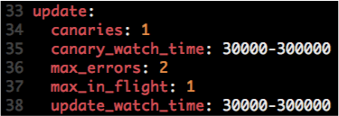
Canary Deployments
Manifest

Slide 35
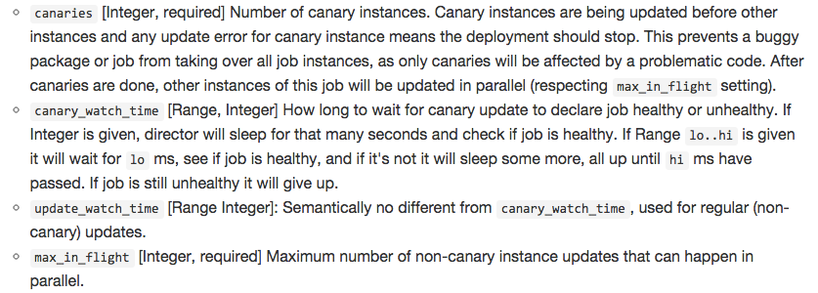
How Do Canary Deployments Work?

Slide 36
How Do Canary Deployments Work?
No downtime, atomic rolling update

Slide 37



How Do Canary Deployments Work?
Example:
# of Canaries: 2
Max in Flight: 2
Canaries
v1.0
v1.1

Slide 38

How Do Canary Deployments Work?
Example:
# of Canaries: 2
Max in Flight: 2
Once failed, Canary VMs are kept for troubleshooting purposes.
v1.1
v1.2

Slide 39
How Do Canary Deployments Work?
Example:
# of Canaries: 2
Max in Flight: 2
Once failed, Canary VMs are kept for troubleshooting purposes.
v1.1
v1.2

Slide 40
BOSH – Purpose-built for “Day 2 Operations”
Consistent, Reliable, Scalable, Secure
Provision
Deploy and Configure
Checks against “desired state to return consistency
No ad hoc automation burden
Manage services, not servers
4 layers of Self Healing
Current
State
Desired
State
Re-mediate
Monitor and Detect

Slide 41
Troubleshooting a BOSH deployment

Slide 42
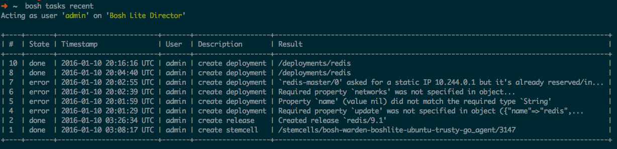
BOSH tasks
bosh tasks recent

Slide 43
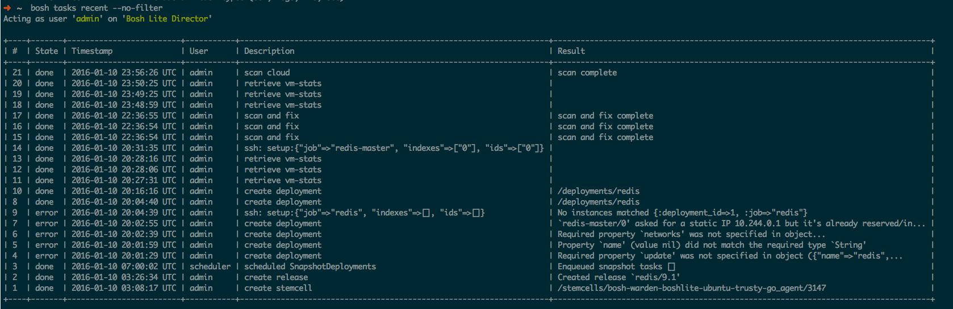
BOSH tasks
bosh tasks recent –no-filter

Slide 44
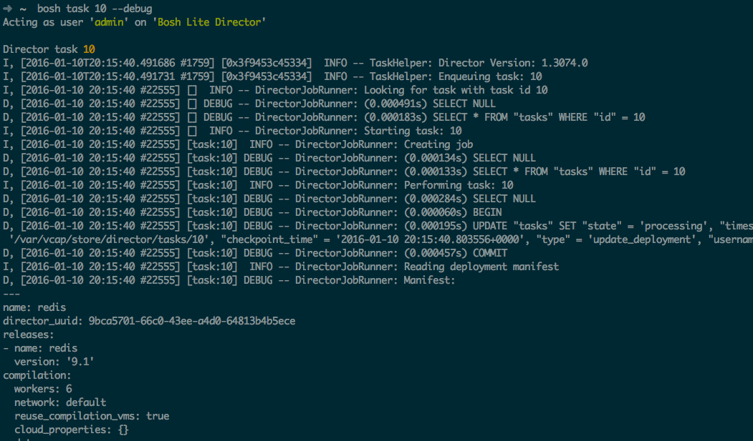
Debug a BOSH task
bosh task 10 --debug

Slide 45
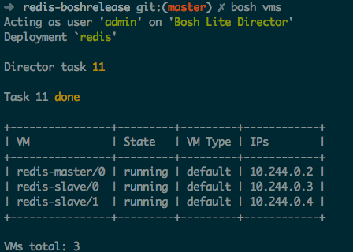
List VMs
bosh vms
running: indicates that all release job’s processes are successfully running at that moment
failing: indicates one of the release job’s processes is not successfully running (could be failing to start, or exiting after some time, etc.)
unresponsive: the Director did not receive any response from the Agent

Slide 46
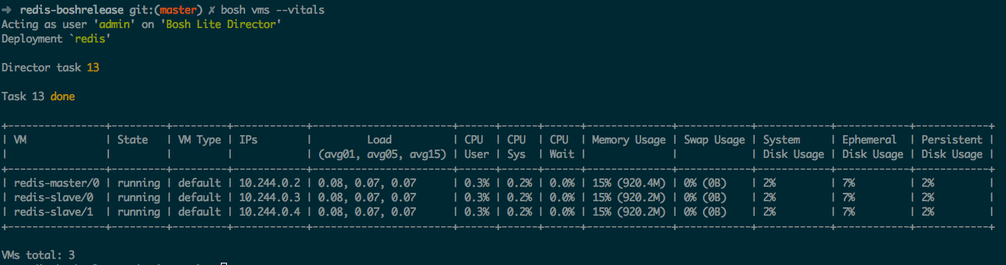
Monitor VM’s state and vitals
bosh vms --vitals

Slide 47
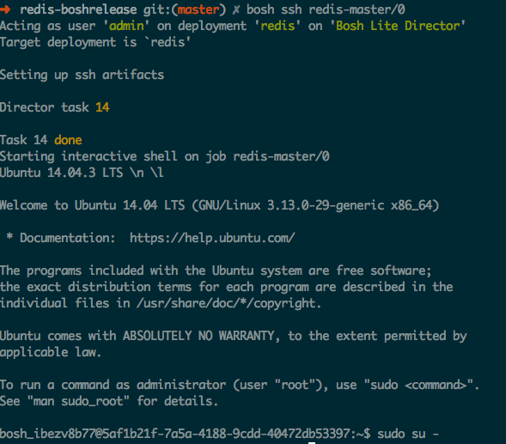
SSH into a VM
bosh ssh job/index
The Agent on each VM sends an alert when someone/something tries to log into the system via SSH. Successful and failed attempts are recorded.
Some IaaS set a “secret” root password. By default is “c1oudcw0” (SHHH!!!)

Slide 48
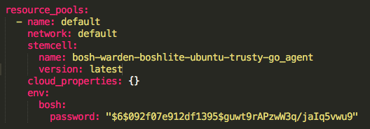
Setting a custom root password
Hashed password - Generate SHA hash using “mkpasswd -m sha-512”

Slide 49
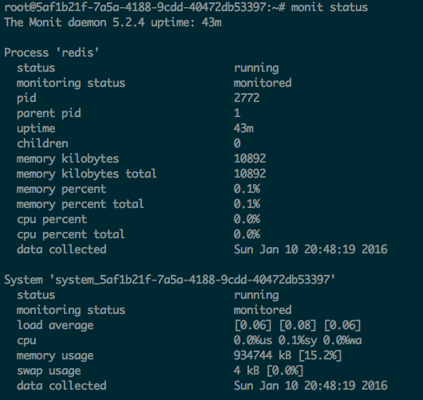
Process health-check
“monit summary”
“monit (status|start|stop)”
https://mmonit.com/monit/

Slide 50
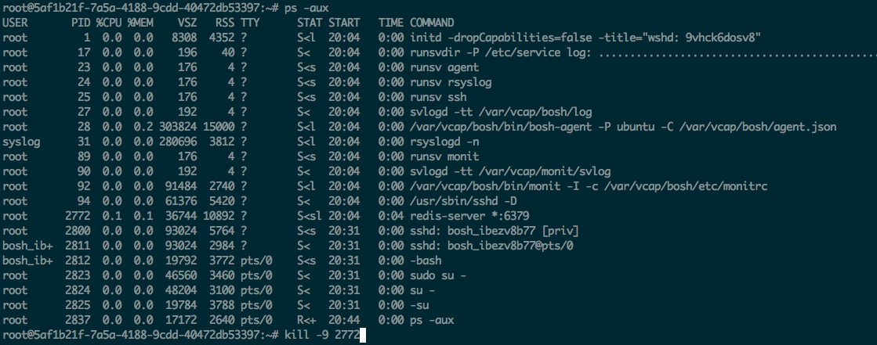
Process recovery in action
If a process dies, the BOSH agent will restart it again automatically

Slide 51
VM health-check
The Health Monitor continiously checks the presence of the deployed VMs.
The Agent on each VM produces a heartbeat every minute and sends it to the Health Monitor.
The Health Monitor is extended by a set of plugins. Each plugin is given an opportunity to act on each heartbeat, so in cases of failure it can notify external services or perform actions against the Director.

Slide 52
Health Monitor plugins
Event Logger: Logs events to a file
Resurrector: Recreates VMs that have stopped heartbeating
Emailer: Sends configurable e-mails on events reciept
OpenTSDB: Sends events to OpenTSDB
Graphite: Sends events to Graphite
PagerDuty: Sends events to PagerDuty.com using their API
DataDog: Sends events to DataDog.com using their API
AWS CloudWatch: Sends events to Amazon’s CloudWatch using their API
Configuring Health Monitor: http://bosh.io/docs/hm-config.html

Slide 53
Resurrector Health Monitor plugin
It’s responsible for automatically recreating VMs that become inaccessible.
It continiously cross-references VMs expected to be running against the VMs that are sending heartbeats. When resurrector does not receive heartbeats for a VM for a certain period of time, it will kick off a task on the Director (scan and fix task) to try to “resurrect” that VM.
Under certain conditions the Resurrector will consider the system in the “meltdown” and will stop sending requests to the Director.

Slide 54
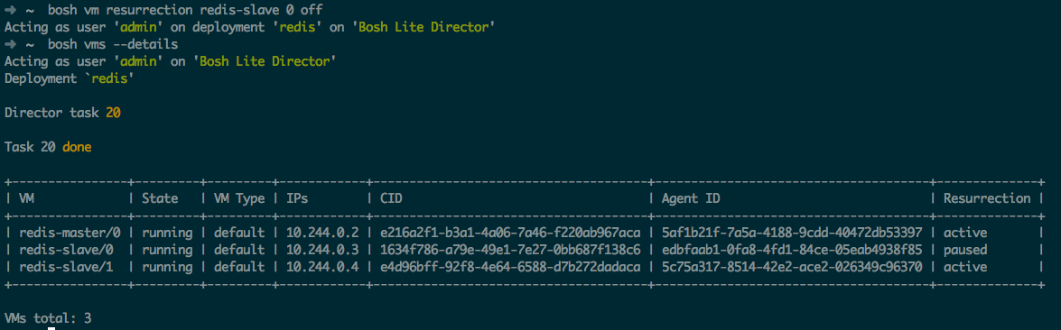
Disabling manually the Resurrector
“bosh vm resurrection job index on|off”

Slide 55
Manual repair with Cloud Check
BOSH provides the Cloud Check CLI command (a.k.a cck) to repair IaaS resources used by a specific deployment. It is not commonly used while normal operations; however, it becomes essential when some IaaS operations failed and the Director cannot resolve problems without a human decision or when the Resurrector is not enabled.
VM is missing
VM is not responsive (unresponsive agent)
Persistent Disk is not attached
Persistent Disk is missing

Slide 56
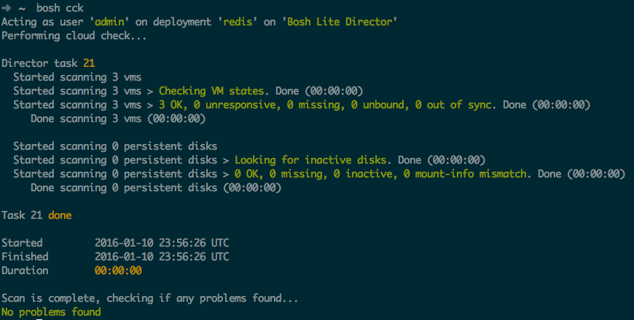
Manual repair with Cloud Check
bosh cck

Slide 57
VM Configuration Locations
/var/vcap/bosh/log/current: current BOSH agent log
/var/vcap/monit/monit.log: Monit activity log. Includes information about starts, stops, restarts, etc. of release job processes monitored by Monit

Slide 58
VM Configuration Locations
/var/vcap/jobs: contains evaluated release jobs for the assigned deployment job
/var/vcap/packages: contains enabled release packages for the assigned deployment job
/var/vcap/data: used by the release jobs to keep ephemeral data
/var/vcap/store: used by the release jobs to keep persistent data

Slide 59
VM Configuration Locations
/var/vcap/sys/run: directory that is used by the release jobs to keep miscellaneous ephemeral data about currently running processes, for example, pid and lock files
/var/vcap/sys/log: directory that is used by the release jobs to keep logs

Slide 60
Log rotation
BOSH log rotates release job logs with the Logrotate log file management utility with the following non-configurable settings:
missingok: Skip missing log files and do not generate an error message
rotate 7: Keep seven log files at a time
compress: Compress old log files with gzip
delaycompress: Postpone compression of log files until the next rotation cycle
copytruncate: Copy log files, then truncate in place instead of creating new files
size 50M: Rotate log files when they exceed 50 MB in size.

Slide 61
Open.
Agile.
Cloud-Ready.

